Slide 1
Refugees/Immigrants
BY Abdullah Hassan

Slide 2
Context, Motivation, Method/Sources
As per the United Nations, 80+ million people displaced by the end of 2020.
Due to increase in Conflict, violence, persecution and human rights violations.
We’ll be looking at trends of Refugee families that resettled in the U.S overtime.
This is my passionate story since I came to U.S as a Somali Refugee in 2004.
Data Analysis Method-Find Data-Cleaning and visuals in Excel & Power Bi.
Data Sources include Department of State, UNHCR, Migration Policy Institute.

Slide 3
Terminology
A refugee is a person who has fled their own country for safety and security due to being at risk of serious human rights violations and persecution if they stay.
Asylum-seeker is a one who has left their country to seek protection from serious human rights violations in another country, but not legally recognized a refugee.
Affirmative asylum processing involves your physical presence in the United States while defensive asylum is when requesting asylum to prevent removal.
Internally displaced persons(IDPs) due to conflict and violence in a country.
IDPs stay with their countries & likely to get less international attention/help.
The United Nations High Commissioner for Refugees(UNHCR) is a UN agency mandated to aid and protect refugees, forcibly displaced communities, to assist in their voluntary repatriation, local integration or resettlement to third country.

Slide 4
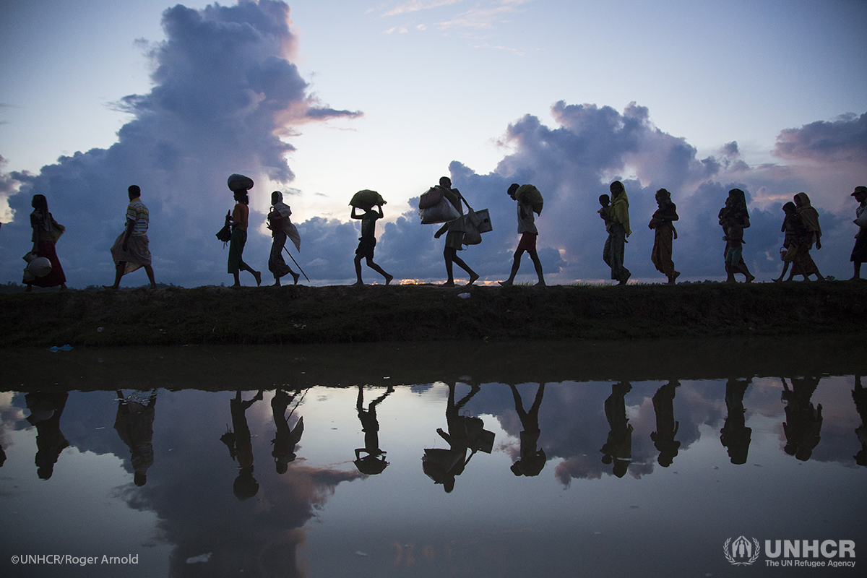
Journey Of A Refugee
Refugee will first likely Flee to neighboring host Countries.
Most end up in a refugee Camp.
Some are sent back to his/her home country as Voluntary Repatriation.
Only 1% get to resettle in third country like U.S for Opportunities.
Since 1980, the U.S. has resettled more refugees than other country.

Slide 7
U.S. Refugee Ceiling & Resettlement

Slide 8
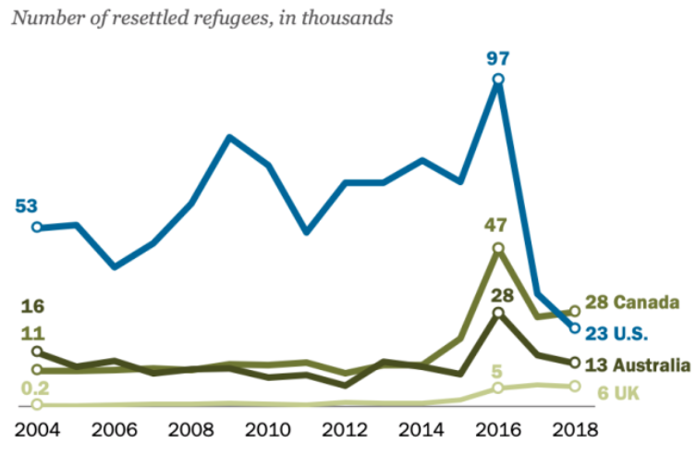
U.S. refugee resettlement drop
https://www.weforum.org/agenda/2019/06/canada-now-leads-the-world-in-refugee-resettlement-surpassing-the-u-s/

Slide 9
Top 10 Countries-2004

Slide 11
Asylum Seekers

Slide 12
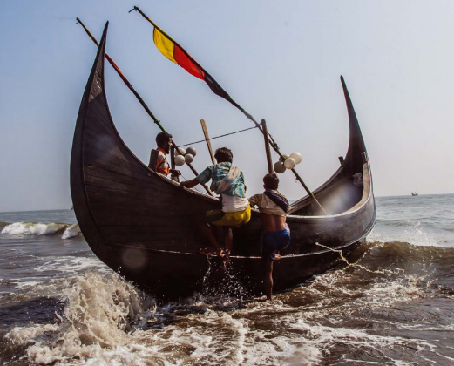
Refugees/IDPs Struggles/Resilience
Refugees face challenges fleeing their home.
By land, sea, or air with their lives in search for a place that offers safety & more opportunities.
Most end up in conflict zones especially IDPs.
Refugees suffer from (PTSD) especially kids.
All got stories of their struggles and resilience.
They still strive to carry on with their lives.
These that get opportunity to resettle in U.S strive to integrate and give back in many ways.

Slide 13

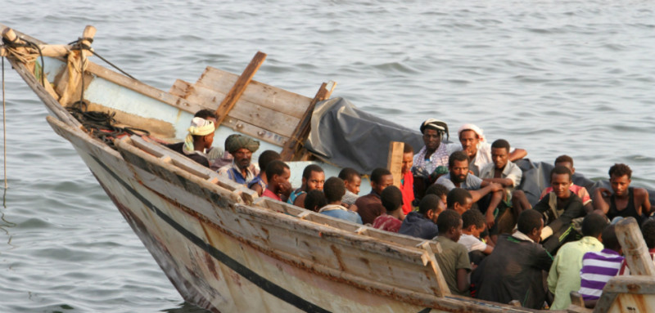
Finding/Recommendations
The count of Refugees, IDPS etc. is going up.
U.S was at top of Countries that gives most funding & to Resettle more Refugees overall.
Canada resettled more refugees(28,100) in 2018, since U.S passed the 1980 Refugee Act.
IDPS face most challenges in conflict zones.
More Access to clean water, Education HealthCare etc. for refugees and IDPs.
More options for Voluntary Return for refugees that can rebuild their countries.

Slide 14




Local and International Refugee Agencies
Local:
International:

Slide 15
Reference & Articles
https://www.wrapsnet.org/admissions-and-arrivals/
https://www.migrationpolicy.org/proghttps://immigrationforum.org/article/fact-sheet-u-s-refugee-resettlement/rams/data-hub/charts/immigrant-population-over-time
https://www.dhs.gov/immigration-statistics/refugees-asylees
https://www.weforum.org/agenda/2019/06/canada-now-leads-the-world-in-refugee-resettlement-surpassing-the-u-s/
https://data.humdata.org/search?q=Syria+Refugee+Camps&page=3https://www.weforum.org/agenda/2019/01/from-a-refugee-camp-to-davos-one-co-chair-s-story
Thank you!

